Slide 1

Software Engineering
Requirements Engineering Activities

Slide 2
Lesson Learning Outcomes
Know the definition of Requirement Engineering (RE) or Software Specification.
1
Differentiate between Requirements definition and Requirements specifications
2
Differentiate between user requirements and System Requirements
3
Understand the functional and Non-functional requirements
4

Slide 3

From the previous lecture
Software Process Activities
Requirement Engineering (RE) or Requirements analysis: Establishing the system’s services, constraints, and goals.
System and software design: Allocates the require­ments to either hardware or software systems by establishing an overall system architecture.
Implementation and unit testing: The software design is real­ized as a set of programs or program units. Unit testing involves verifying that each unit meets its specifications.
Integration and system testing: The individual program units or programs are integrated and tested as a complete system to ensure that the software requirements have been met.
Operation and maintenance: The system is installed and put into practical use. Maintenance involves correcting errors and enhancing the system’s services as new requirements are discovered

Slide 4
What is Requirements Engineering?
The process of understanding and defining what services are required from the system and identifying the con­straints on the system’s operation and development.
It aims to produce an agreed requirements document that specifies a system satisfying stakeholder requirements.

Slide 5
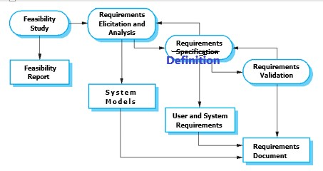
Requirements Engineering Activitiess
1
2
3
4
This is also called Requirements
Specification Document RSD

Slide 6

Requirements Engineering Activities
Feasibility study
Considers the system’s effectiveness from a business point of view and if it can be developed within existing budgetary constraints.
It should be quick and cheap
Requirements elicitation and analysis
Deriving the system requirements through many ways.
May involve the develop­ment of one or more system models and prototypes to help understand the proposed system

Slide 7
Requirements Engineering Activities
Requirements specification Definition: Trans­lating the information gathered during the analysis activity into a document that defines two types of requirements.
High-level User Requirements: Abstract statements of the system require­ments for the customer and end-user of the system.
System requirements: A detailed description of the functionality to be provided.
Requirements validation: Checks the requirements for realism, consis­tency, and completeness.
errors in the requirements document are inevitably discovered.
It must then be modified to correct these problems.

Slide 8
Types requirements
Functional requirements
The statements of services the system should provide, how the system should react to particular inputs, and how the system should behave in particular situations.
In some cases, the functional require­ments may also explicitly state what the system should not do.
Non-Functional Requirements
The constraints on the services or functions offered by the system. Such as: timing constraints, constraints on the devel­opment process, and constraints imposed by standards (e.g., reliability, usability, privacy, security, maintainability)
Apply to the system as a whole, rather than individual system features or services.

Slide 9
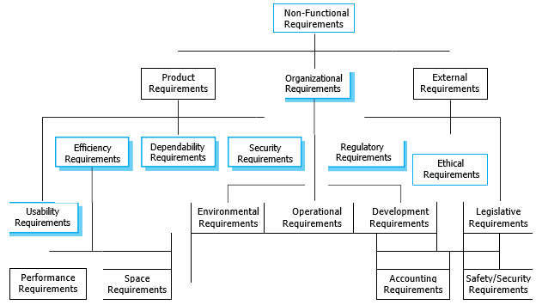
Non-Functional Requirements

Slide 10
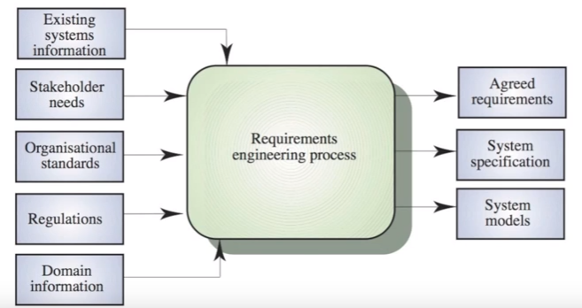
RE Inputs and Output

Slide 11

YouTube Link At the remaining time of the lecture, the students can watch this link to RE activities
https://www.youtube.com/watch?v=GSe4xIy-iBE&list=PLpQUJygQ38u_YwDYiI6u0cY_ti2_eHfKe&index=3

